Slide 1
Introduction to Differential Equations - Lecture 11
Fei Qi
Email: fei.qi@du.edu
Office Hour: TBA
Website: https://feiqimath.github.io

Slide 2
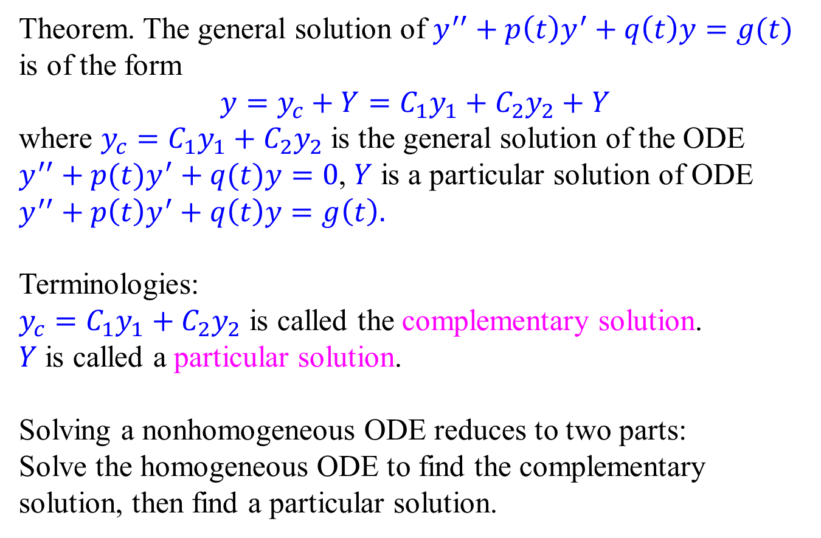
Structure theorem of the general solution
Theorem. The general solution of $y^{′′}+p\left(t\right)y^{′}+q\left(t\right)y=g(t)$ is of the form $$y=y_{c}+Y=C_{1}y_{1}+C_{2}y_{2}+Y$$
where $y_{c}=C_{1}y_{1}+C_{2}y_{2}$ is the general solution of the ODE $y^{′′}+p(t)y^{′}+q(t)y=0$, $Y$ is a particular solution of ODE $y^{′′}+p\left(t\right)y^{′}+q\left(t\right)y=g\left(t\right).$
Terminologies:
$y_{c}=C_{1}y_{1}+C_{2}y_{2}$ is called the complementary solution.
$Y$ is called a particular solution.
Solving a nonhomogeneous ODE reduces to two parts: Solve the homogeneous ODE to find the complementary solution, then find a particular solution.

Slide 3
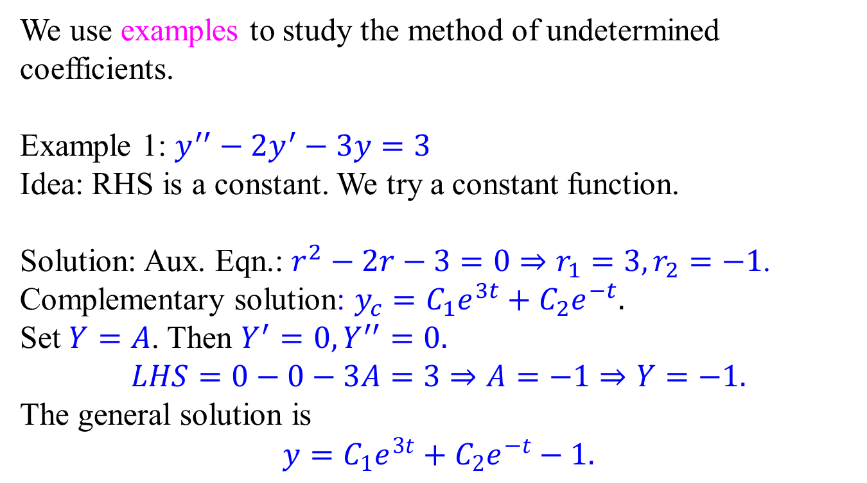
Method of Undetermined Coefficients
We use examples to study the method of undetermined coefficients.
Example 1: $y^{′′}−2y^{′}−3y=3$
Idea: RHS is a constant. We try a constant function.
Solution: Aux. Eqn.: $r^{2}−2r−3=0⇒r_{1}=3,r_{2}=−1$.
Complementary solution: $y_{c}=C_{1}e^{3t}+C_{2}e^{−t}.$
Set $Y=A$. Then $Y^{′}=0,Y^{′′}=0.$
$$LHS=0−0−3A=3⇒A=−1⇒Y=−1.$$
The general solution is
$$y=C_{1}e^{3t}+C_{2}e^{−t}−1.$$

Slide 4
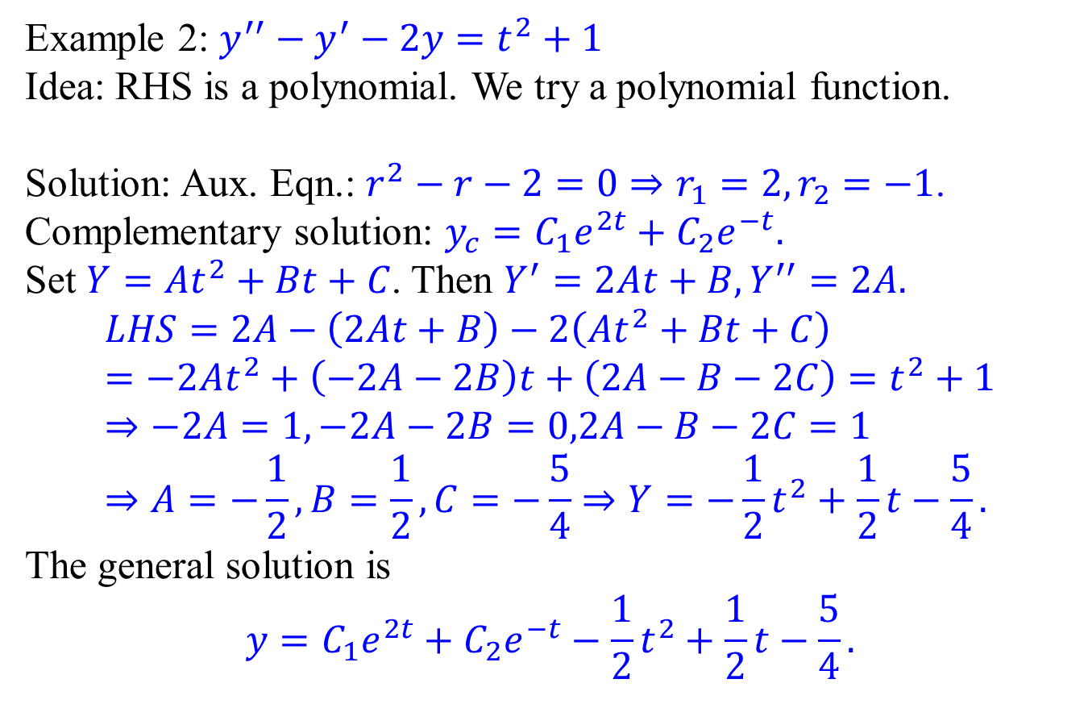
Method of Undetermined Coefficients
Example 2: $y^{′′}−y^{′}−2y=t^{2}+1$
Idea: RHS is a polynomial. We try a polynomial function.
Solution: Aux. Eqn.: $r^{2}−r−2=0⇒r_{1}=2,r_{2}=−1$.
Complementary solution: $y_{c}=C_{1}e^{2t}+C_{2}e^{−t}.$
Set $Y=At^{2}+Bt+C$. Then $Y^{′}=2At+B,Y^{′′}=2A.$
$$LHS=2A−\left(2At+B\right)−2\left(At^{2}+Bt+C\right) \\ =−2At^{2}+\left(−2A−2B\right)t+\left(2A−B−2C\right)=t^{2}+1 \\ ⇒−2A=1,−2A−2B=0,2A−B−2C=1 \\ ⇒A=−\frac{1}{2},B=\frac{1}{2},C=−\frac{5}{4}⇒Y=−\frac{1}{2}t^{2}+\frac{1}{2}t−\frac{5}{4}.$$
The general solution is
$$y=C_{1}e^{2t}+C_{2}e^{−t}−\frac{1}{2}t^{2}+\frac{1}{2}t−\frac{5}{4}.$$

Slide 5
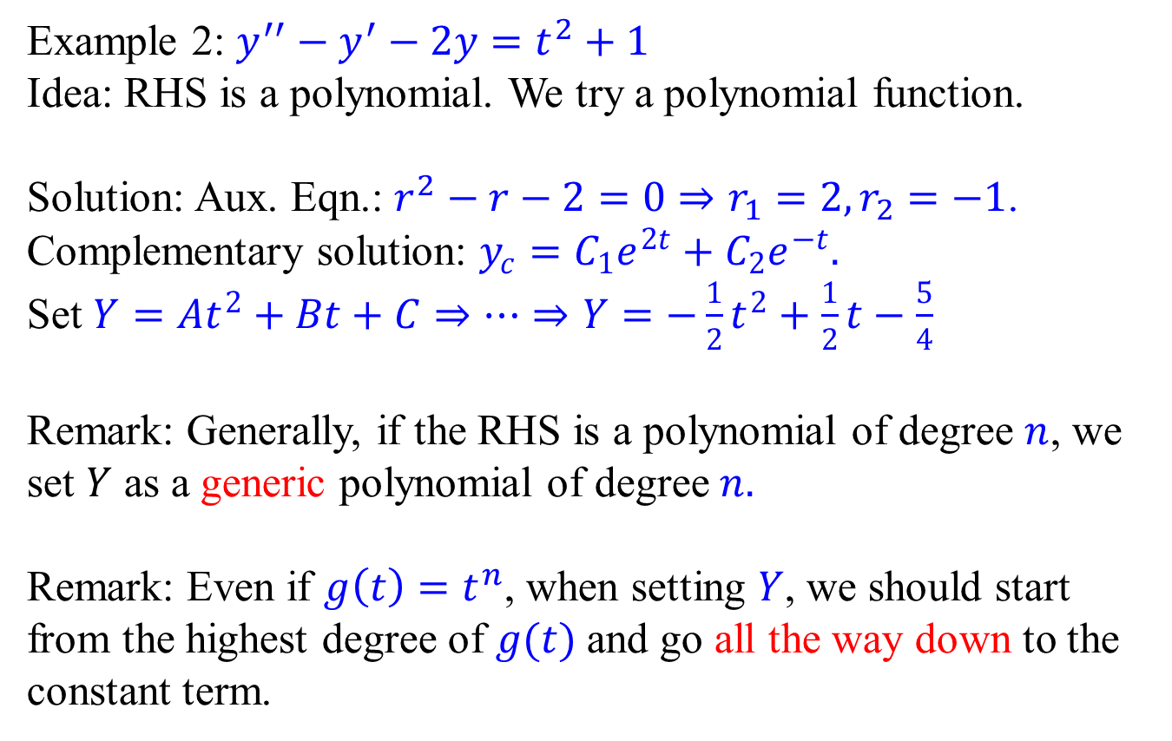
Method of Undetermined Coefficients
Example 2: $y^{′′}−y^{′}−2y=t^{2}+1$
Idea: RHS is a polynomial. We try a polynomial function.
Solution: Aux. Eqn.: $r^{2}−r−2=0⇒r_{1}=2,r_{2}=−1$.
Complementary solution: $y_{c}=C_{1}e^{2t}+C_{2}e^{−t}.$
Set $Y=At^{2}+Bt+C⇒⋯⇒Y=−\frac{1}{2}t^{2}+\frac{1}{2}t−\frac{5}{4}$
Remark: Generally, if the RHS is a polynomial of degree $n$, we set $Y$ as a generic polynomial of degree$n.$
Remark: Even if $g\left(t\right)=t^{n}$, when setting $Y$, we should start from the highest degree of $g(t)$ and go all the way down to the constant term.

Slide 6
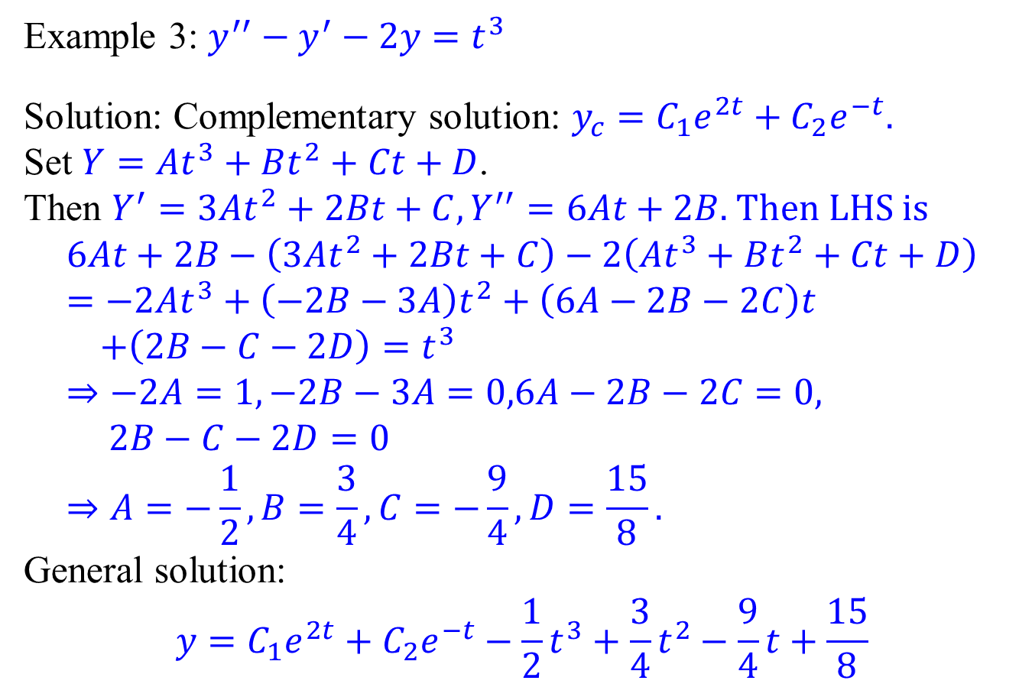
Method of Undetermined Coefficients
Example 3: $y^{′′}−y^{′}−2y=t^{3}$
Solution: Complementary solution: $y_{c}=C_{1}e^{2t}+C_{2}e^{−t}.$
Set $Y=At^{3}+Bt^{2}+Ct+D$.
Then $Y^{′}=3At^{2}+2Bt+C, Y^{′′}=6At+2B.$ Then LHS is
$$6At+2B−\left(3At^{2}+2Bt+C\right)−2\left(At^{3}+Bt^{2}+Ct+D\right) \\ =−2At^{3}+\left(−2B−3A\right)t^{2}+\left(6A−2B−2C\right)t \\ +\left(2B−C−2D\right)=t^{3} \\ ⇒−2A=1,−2B−3A=0,6A−2B−2C=0, \\ 2B−C−2D=0 \\ ⇒A=−\frac{1}{2}, B=\frac{3}{4},C=−\frac{9}{4},D=\frac{15}{8}.$$
General solution:
$$y=C_{1}e^{2t}+C_{2}e^{−t}−\frac{1}{2}t^{3}+\frac{3}{4}t^{2}−\frac{9}{4}t+\frac{15}{8}$$

Slide 7
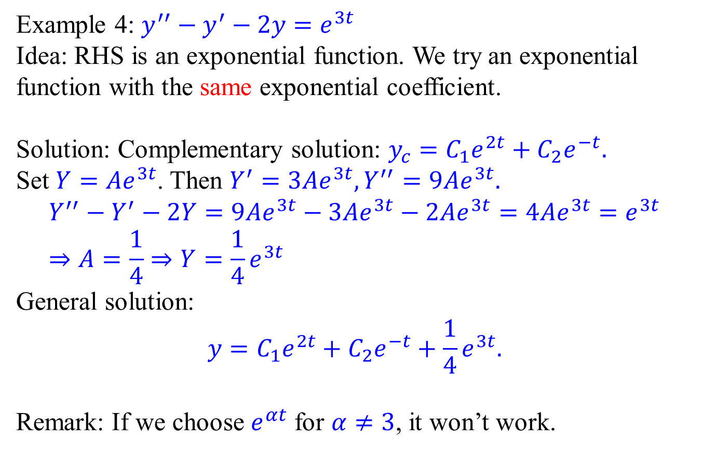
Method of Undetermined Coefficients
Example 4: $y^{′′}−y^{′}−2y=e^{3t}$
Idea: RHS is an exponential function. We try an exponential function with the same exponential coefficient.
Solution: Complementary solution: $y_{c}=C_{1}e^{2t}+C_{2}e^{−t}.$
Set $Y=Ae^{3t}$. Then $Y^{′}=3Ae^{3t}, Y^{′′}=9Ae^{3t}.$ $$Y^{′′}−Y^{′}−2Y=9Ae^{3t}−3Ae^{3t}−2Ae^{3t}=4Ae^{3t}=e^{3t} \\ ⇒A=\frac{1}{4}⇒Y=\frac{1}{4}e^{3t}$$
General solution:
$$y=C_{1}e^{2t}+C_{2}e^{−t}+\frac{1}{4}e^{3t}.$$
Remark: If we choose $e^{αt}$ for $α≠3$, it won’t work.

Slide 8
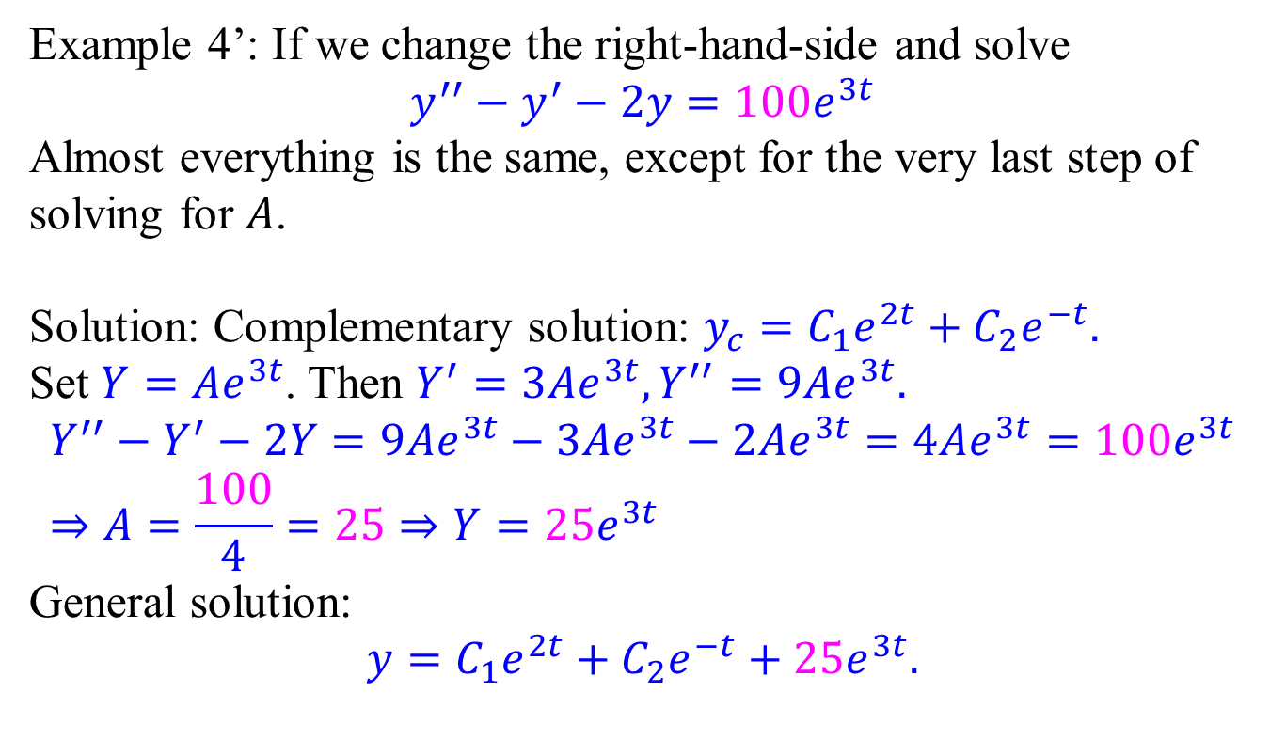
Method of Undetermined Coefficients
Example 4’: If we change the right-hand-side and solve
$$y^{′′}−y^{′}−2y=100e^{3t}$$
Almost everything is the same, except for the very last step of solving for $A$.
Solution: Complementary solution: $y_{c}=C_{1}e^{2t}+C_{2}e^{−t}.$
Set $Y=Ae^{3t}$. Then $Y^{′}=3Ae^{3t}, Y^{′′}=9Ae^{3t}.$ $$Y^{′′}−Y^{′}−2Y=9Ae^{3t}−3Ae^{3t}−2Ae^{3t}=4Ae^{3t}={100e}^{3t} \\ ⇒A=\frac{100}{4}=25⇒Y=25e^{3t}$$
General solution:
$$y=C_{1}e^{2t}+C_{2}e^{−t}+25e^{3t}.$$

Slide 9
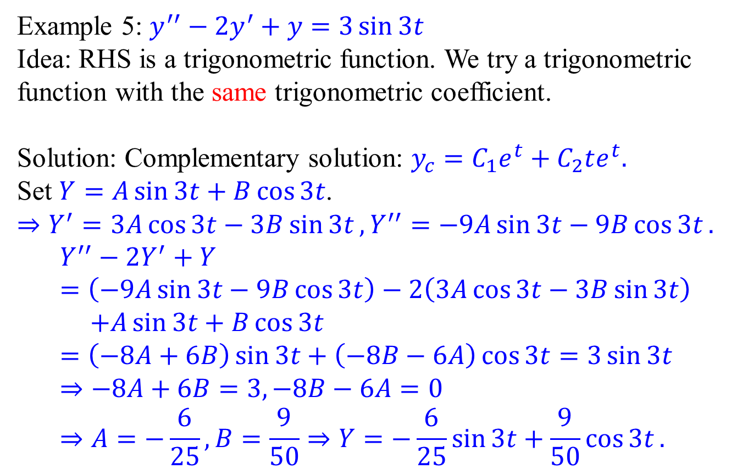
Method of Undetermined Coefficients
Example 5: $y^{′′}−{2y}^{′}+y=3\sin{3t}$
Idea: RHS is a trigonometric function. We try a trigonometric function with the same trigonometric coefficient.
Solution: Complementary solution: $y_{c}=C_{1}e^{t}+C_{2}te^{t}.$
Set $Y=A\sin{3t}+B\cos{3t}$.
$⇒Y^{′}=3A\cos{3t}−3B\sin{3t}, Y^{′′}=−9A\sin{3t}−9B\cos{3t}.$
$$Y^{′′}−2Y^{′}+Y=\left(−9A\sin{3t}−9B\cos{3t}\right)−2\left(3A\cos{3t}−3B\sin{3t}\right) \\ +A\sin{3t}+B\cos{3t} \\ =\left(−8A+6B\right)\sin{3t}+\left(−8B−6A\right)\cos{3t}=3\sin{3t} \\ ⇒−8A+6B=3,−8B−6A=0 \\ ⇒A=−\frac{6}{25},B=\frac{9}{50}⇒Y=−\frac{6}{25}\sin{3t}+\frac{9}{50}\cos{3t}.$$
Note that both sin and cos should appear.

Slide 10
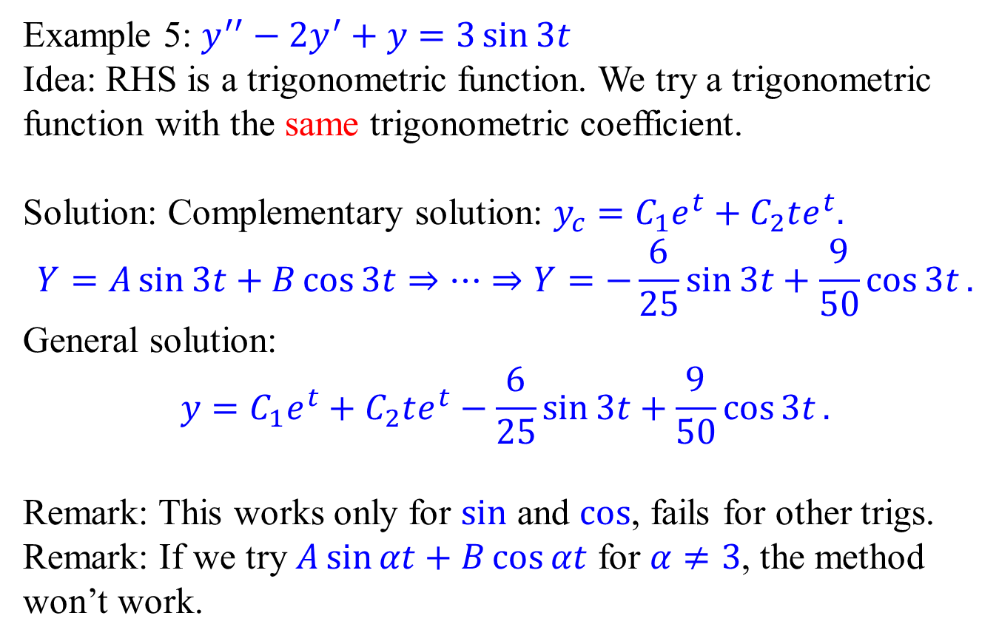
Method of Undetermined Coefficients
Example 5: $y^{′′}−{2y}^{′}+y=3\sin{3t}$
Idea: RHS is a trigonometric function. We try a trigonometric function with the same trigonometric coefficient.
Solution: Complementary solution: $y_{c}=C_{1}e^{t}+C_{2}te^{t}.$
$$Y=A\sin{3t}+B\cos{3t}⇒⋯⇒Y=−\frac{6}{25}\sin{3t}+\frac{9}{50}\cos{3t}.$$
General solution:
$$y=C_{1}e^{t}+C_{2}te^{t}−\frac{6}{25}\sin{3t}+\frac{9}{50}\cos{3t}.$$
Remark: This works only for sin and cos, fails for other trigs.
Remark: If we try $A\sin{αt}+B\cos{αt}$ for $α≠3$, the method won’t work.

Slide 11
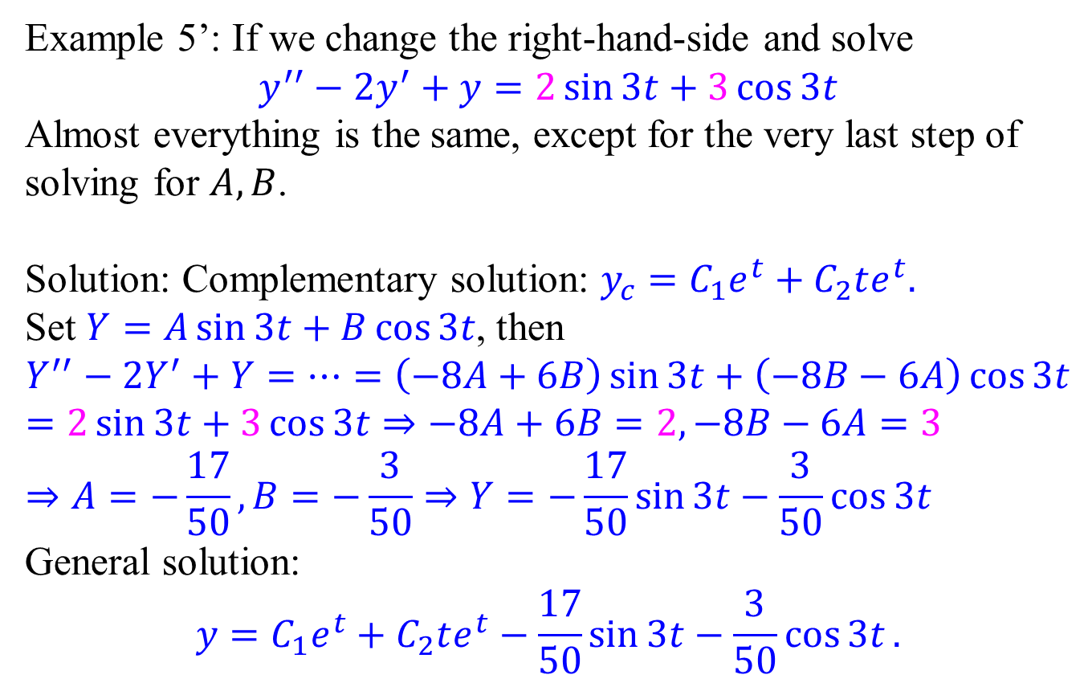
Method of Undetermined Coefficients
Example 5’: If we change the right-hand-side and solve
$$y^{′′}−{2y}^{′}+y=2\sin{3t}+3\cos{3t}$$
Almost everything is the same, except for the very last step of solving for $A, B$.
Solution: Complementary solution: $y_{c}=C_{1}e^{t}+C_{2}te^{t}.$
Set $Y=A\sin{3t}+B\cos{3t}$, then
$$Y^{′′}−2Y^{′}+Y=⋯=\left(−8A+6B\right)\sin{3t}+\left(−8B−6A\right)\cos{3t}=2\sin{3t}+3\cos{3t}⇒−8A+6B=2,−8B−6A=3 \\ ⇒A=−\frac{17}{50},B=−\frac{3}{50}⇒Y=−\frac{17}{50}\sin{3t}−\frac{3}{50}\cos{3t}$$
General solution:
$$y=C_{1}e^{t}+C_{2}te^{t}−\frac{17}{50}\sin{3t}−\frac{3}{50}\cos{3t}.$$

Slide 12
Important Conceptual Remarks
The method works because
Derivatives of polynomial functions are polynomials (up to the same degree).
Derivatives of exponential functions are exponential functions (with the same exponential coefficient).
Derivatives of sine and cosine functions are sine and cosine functions (with the same trigonometric coefficient).
For functions without this property, the method fails. You will have to use the integration formula.
The polynomials, exponentials, sine and cosine functions are referred as the basic types. Observe that products of basic type functions satisfy the same property.

Slide 13
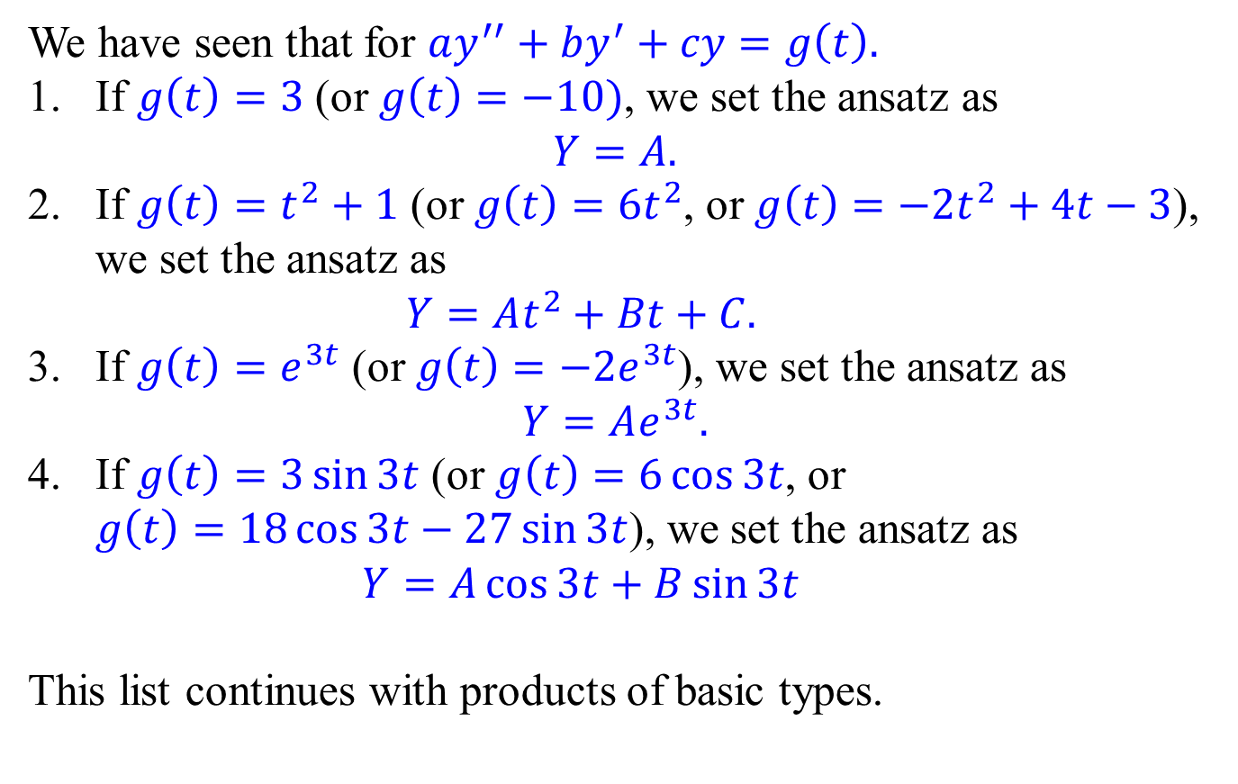
The first ansatz
We have seen that for $ay^{′′}+by^{′}+cy=g\left(t\right).$
If $g\left(t\right)=3$ (or $g\left(t\right)=−10)$, we set the ansatz as $Y=A.$
If $g\left(t\right)=t^{2}+1$ (or $g\left(t\right)=6t^{2}$, or $g\left(t\right)=−2t^{2}+4t−3$), we set the ansatz as $Y=At^{2}+Bt+C.$
If $g\left(t\right)=e^{3t}$ (or $g\left(t\right)=−2e^{3t}$), we set the ansatz as
$$Y=Ae^{3t}.$$
If $g\left(t\right)=3\sin{3t}$ (or $g\left(t\right)=6\cos{3t}$, or $g\left(t\right)=18\cos{3t}−27\sin{3t}$), we set the ansatz as $Y=A\cos{3t}+B\sin{3t}$
This list continues with products of basic types.

Slide 14
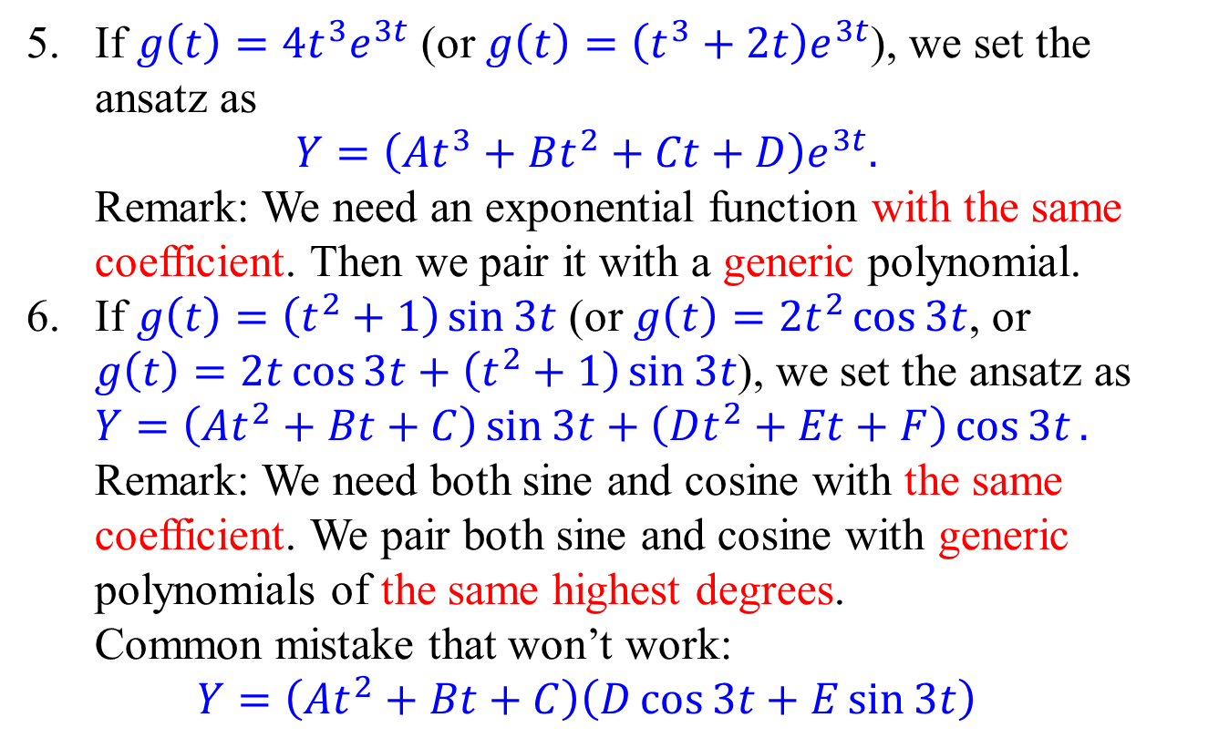
The first ansatz
If $g\left(t\right)=4t^{3}e^{3t}$ (or $g\left(t\right)=\left(t^{3}+2t\right)e^{3t}$), we set the ansatz as $Y=\left(At^{3}+Bt^{2}+Ct+D\right)e^{3t}.$ Remark: We need an exponential function with the same coefficient. Then we pair it with a generic polynomial.
If $g\left(t\right)=\left(t^{2}+1\right)\sin{3t}$ (or $g\left(t\right)=2t^{2}\cos{3t}$, or $g\left(t\right)=2t\cos{3t}+\left(t^{2}+1\right)\sin{3t}$), we set the ansatz as $Y=\left(At^{2}+Bt+C\right)\sin{3t}+\left(Dt^{2}+Et+F\right)\cos{3t}.$ Remark: We need both sine and cosine with the same coefficient. We pair both sine and cosine with generic polynomials of the same highest degrees. Common mistake that won’t work: $Y=\left(At^{2}+Bt+C\right)\left(D\cos{3t}+E\sin{3t}\right)$

Slide 15
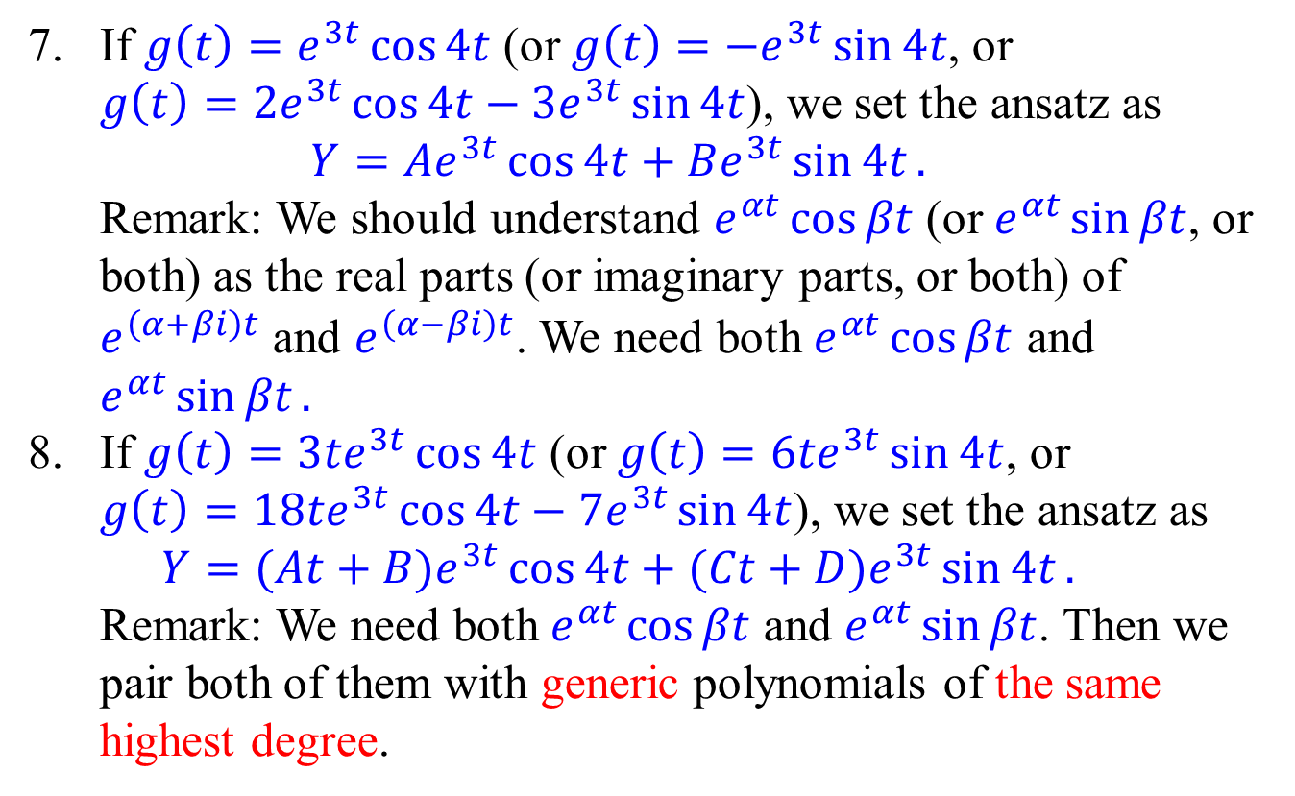
The first ansatz
If $g\left(t\right)=e^{3t}\cos{4t}$ (or $g\left(t\right)=−e^{3t}\sin{4t}$, or $g\left(t\right)=2e^{3t}\cos{4t}−3e^{3t}\sin{4t}$), we set the ansatz as $Y=Ae^{3t}\cos{4t}+Be^{3t}\sin{4t}.$ Remark: We should understand $e^{αt}\cos{βt}$ (or $e^{αt}\sin{βt}$, or both) as the real parts (or imaginary parts, or both) of $e^{\left(α+βi\right)t}$ and $e^{\left(α−βi\right)t}$. We need both $e^{αt}\cos{βt}$ and $e^{αt}\sin{βt}.$
If $g\left(t\right)={3te}^{3t}\cos{4t}$ (or $g\left(t\right)=6te^{3t}\sin{4t}$, or $g\left(t\right)=18te^{3t}\cos{4t}−7e^{3t}\sin{4t}$), we set the ansatz as $Y=(At+B)e^{3t}\cos{4t}+(Ct+D)e^{3t}\sin{4t}.$ Remark: We need both $e^{αt}\cos{βt}$ and $e^{αt}\sin{βt}$. Then we pair both of them with generic polynomials of the same highest degree.

Slide 16
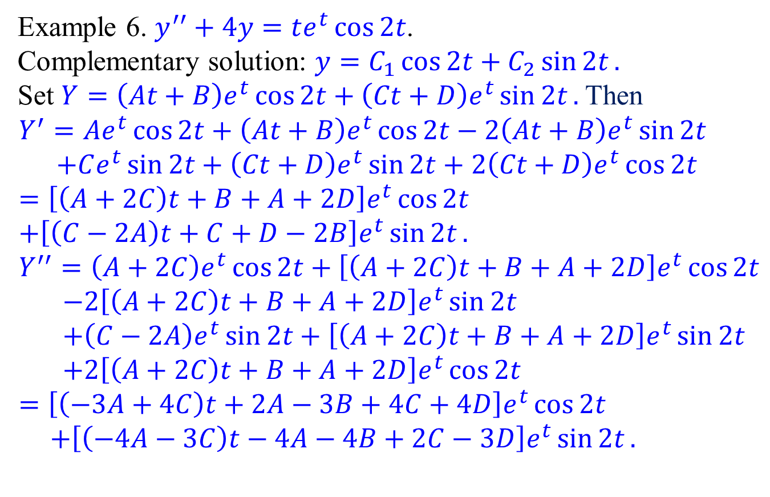
The first ansatz
Example 6. $y^{′′}+4y=te^{t}\cos{2t}$.
Complementary solution: $y=C_{1}\cos{2t}+C_{2}\sin{2t}.$
Set $Y=\left(At+B\right)e^{t}\cos{2t}+\left(Ct+D\right)e^{t}\sin{2t}.$ Then
$$Y^{′}=Ae^{t}\cos{2t}+\left(At+B\right)e^{t}\cos{2t}−2\left(At+B\right)e^{t}\sin{2t} \\ +Ce^{t}\sin{2t}+\left(Ct+D\right)e^{t}\sin{2t}+2\left(Ct+D\right)e^{t}\cos{2t} \\ =\left[\left(A+2C\right)t+B+A+2D\right]e^{t}\cos{2t} \\ +\left[\left(C−2A\right)t+C+D−2B\right]e^{t}\sin{2t}. \\ Y^{′′}=\left(A+2C\right)e^{t}\cos{2t}+\left[\left(A+2C\right)t+B+A+2D\right]e^{t}\cos{2t} \\ −2\left[\left(A+2C\right)t+B+A+2D\right]e^{t}\sin{2t} \\ +\left(C−2A\right)e^{t}\sin{2t}+\left[\left(A+2C\right)t+B+A+2D\right]e^{t}\sin{2t} \\ +2\left[\left(A+2C\right)t+B+A+2D\right]e^{t}\cos{2t} \\ =\left[\left(−3A+4C\right)t+2A−3B+4C+4D\right]e^{t}\cos{2t} \\ +\left[\left(−4A−3C\right)t−4A−4B+2C−3D\right]e^{t}\sin{2t}.$$

Slide 17
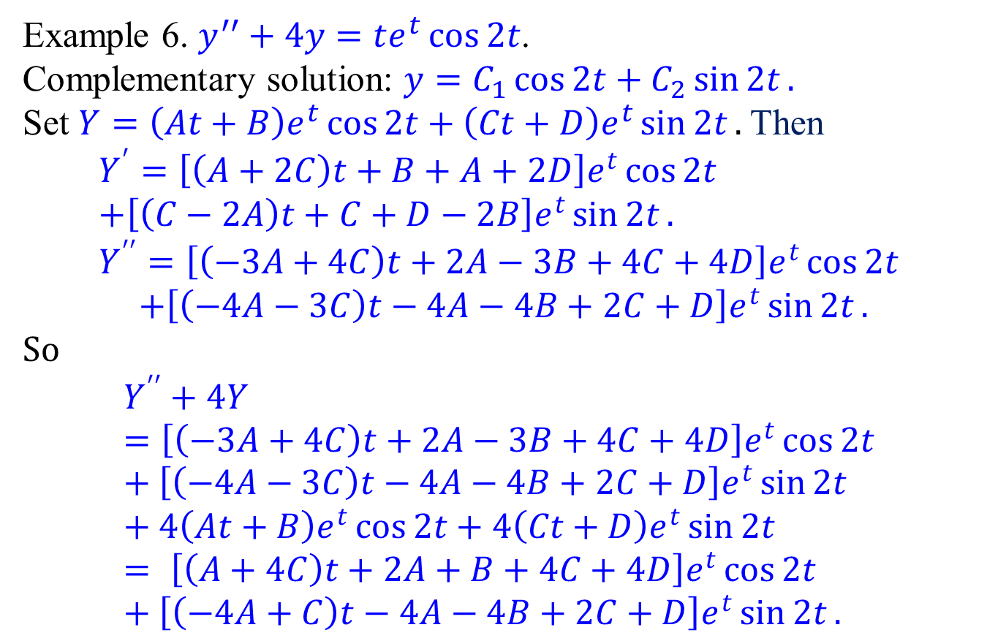
The first ansatz
Example 6. $y^{′′}+4y=te^{t}\cos{2t}$.
Complementary solution: $y=C_{1}\cos{2t}+C_{2}\sin{2t}.$
Set $Y=\left(At+B\right)e^{t}\cos{2t}+\left(Ct+D\right)e^{t}\sin{2t}.$Then
$$Y^{′}=\left[\left(A+2C\right)t+B+A+2D\right]e^{t}\cos{2t} \\ +\left[\left(C−2A\right)t+C+D−2B\right]e^{t}\sin{2t}. \\ Y^{′′}=\left[\left(−3A+4C\right)t+2A−3B+4C+4D\right]e^{t}\cos{2t} \\ +\left[\left(−4A−3C\right)t−4A−4B+2C+D\right]e^{t}\sin{2t}.$$
So
$$Y^{′′}+4Y=\left[\left(−3A+4C\right)t+2A−3B+4C+4D\right]e^{t}\cos{2t}+\left[\left(−4A−3C\right)t−4A−4B+2C+D\right]e^{t}\sin{2t}+4\left(At+B\right)e^{t}\cos{2t}+4\left(Ct+D\right)e^{t}\sin{2t} \\ = \left[\left(A+4C\right)t+2A+B+4C+4D\right]e^{t}\cos{2t}+\left[\left(−4A+C\right)t−4A−4B+2C+D\right]e^{t}\sin{2t}.$$

Slide 18
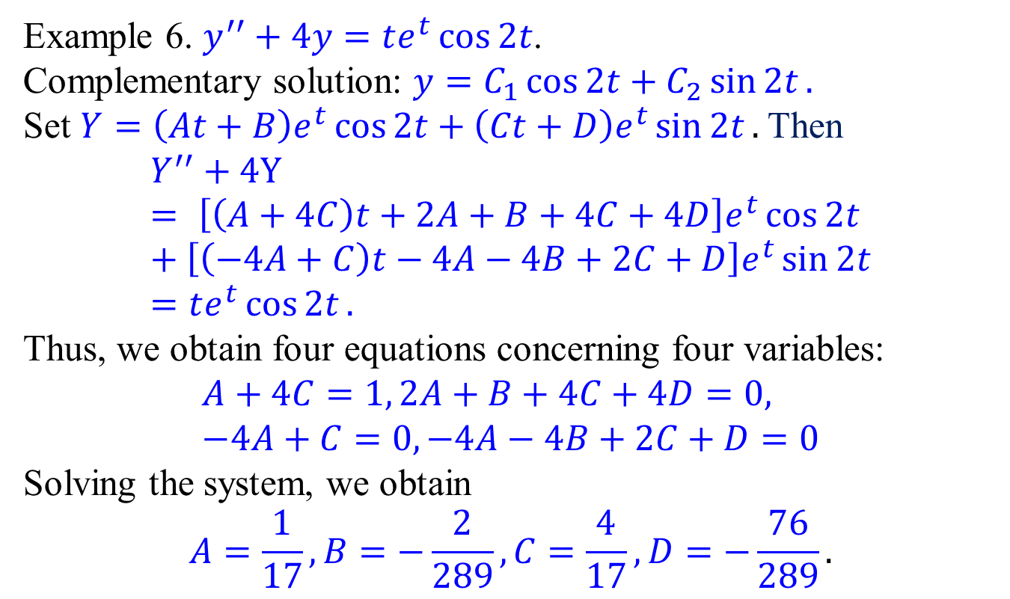
The first ansatz
Example 6. $y^{′′}+4y=te^{t}\cos{2t}$.
Complementary solution: $y=C_{1}\cos{2t}+C_{2}\sin{2t}.$
Set $Y=\left(At+B\right)e^{t}\cos{2t}+\left(Ct+D\right)e^{t}\sin{2t}.$Then
$$Y^{′′}+4Y= \left[\left(A+4C\right)t+2A+B+4C+4D\right]e^{t}\cos{2t}+\left[\left(−4A+C\right)t−4A−4B+2C+D\right]e^{t}\sin{2t} \\ =te^{t}\cos{2t}.$$
Thus, we obtain four equations concerning four variables:
$$A+4C=1, 2A+B+4C+4D=0, \\ −4A+C=0, −4A−4B+2C+D=0$$
Solving the system, we obtain
$$A=\frac{1}{17}, B=−\frac{2}{289},C=\frac{4}{17},D=−\frac{76}{289}.$$

Slide 19
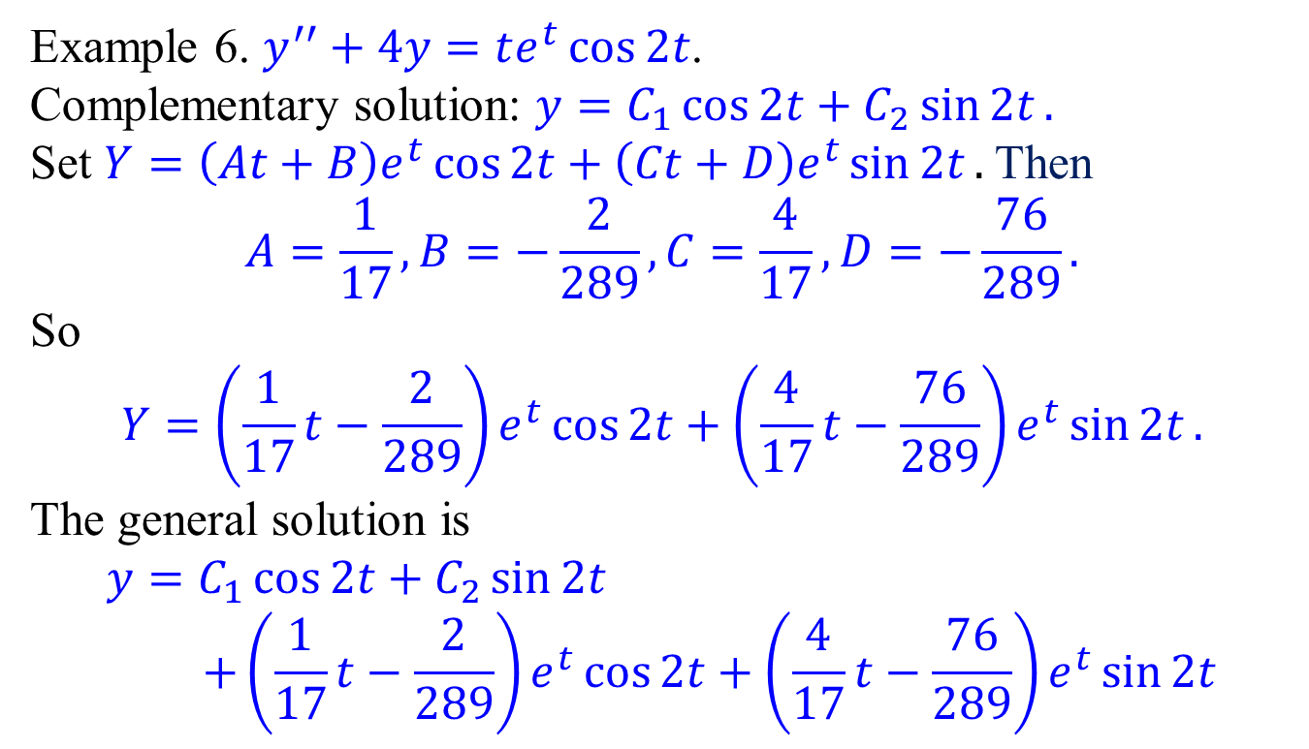
The first ansatz
Example 6. $y^{′′}+4y=te^{t}\cos{2t}$.
Complementary solution: $y=C_{1}\cos{2t}+C_{2}\sin{2t}.$
Set $Y=\left(At+B\right)e^{t}\cos{2t}+\left(Ct+D\right)e^{t}\sin{2t}.$Then
$$A=\frac{1}{17}, B=−\frac{2}{289},C=\frac{4}{17},D=−\frac{76}{289}.$$
So
$$Y=\left(\frac{1}{17}t−\frac{2}{289}\right)e^{t}\cos{2t}+\left(\frac{4}{17}t−\frac{76}{289}\right)e^{t}\sin{2t}.$$
The general solution is
$$y=C_{1}\cos{2t}+C_{2}\sin{2t} \\ +\left(\frac{1}{17}t−\frac{2}{289}\right)e^{t}\cos{2t}+\left(\frac{4}{17}t−\frac{76}{289}\right)e^{t}\sin{2t}$$

Slide 20
The first ansatz
Example 6. $y^{′′}+4y=te^{t}\cos{2t}$.
Complementary solution: $y=C_{1}\cos{2t}+C_{2}\sin{2t}.$
Set $Y=\left(At+B\right)e^{t}\cos{2t}+\left(Ct+D\right)e^{t}\sin{2t}.$Then
$$A=\frac{1}{17}, B=−\frac{2}{289},C=\frac{4}{17},D=−\frac{76}{289}.$$
So
$$Y=\left(\frac{1}{17}t−\frac{2}{289}\right)e^{t}\cos{2t}+\left(\frac{4}{17}t−\frac{76}{289}\right)e^{t}\sin{2t}.$$
The general solution is
$$y=C_{1}\cos{2t}+C_{2}\sin{2t} \\ +\left(\frac{1}{17}t−\frac{2}{289}\right)e^{t}\cos{2t}+\left(\frac{4}{17}t−\frac{76}{289}\right)e^{t}\sin{2t}$$

Slide 21
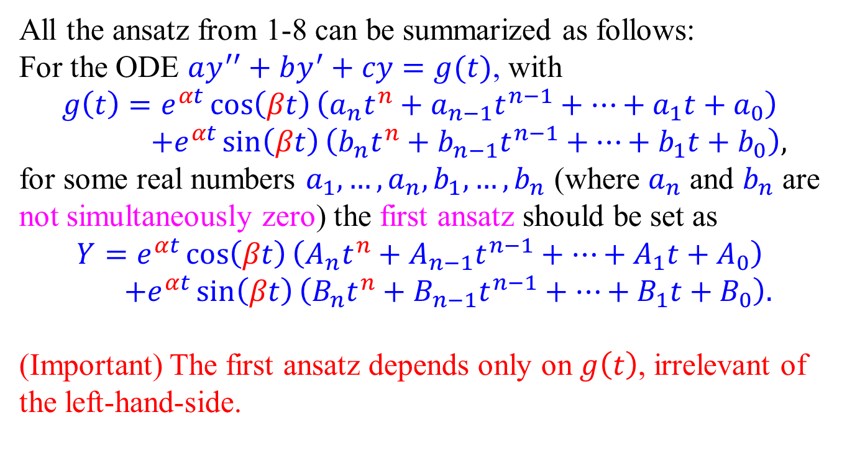
The first ansatz – Summary
All the ansatz from 1-8 can be summarized as follows:
For the ODE $ay^{′′}+by^{′}+cy=g(t)$, with
$$g\left(t\right)=e^{αt}\cos\left(βt\right)\left(a_{n}t^{n}+a_{n−1}t^{n−1}+⋯+a_{1}t+a_{0}\right) \\ +e^{αt}\sin\left(βt\right)\left(b_{n}t^{n}+b_{n−1}t^{n−1}+⋯+b_{1}t+b_{0}\right),$$
for some real numbers $a_{1},…, a_{n}, b_{1},…, b_{n}$ (where $a_{n}$ and $b_{n}$ are not simultaneously zero) the first ansatz should be set as
$$Y=e^{αt}\cos\left(βt\right)\left(A_{n}t^{n}+A_{n−1}t^{n−1}+⋯+A_{1}t+A_{0}\right) \\ +e^{αt}\sin\left(βt\right)\left(B_{n}t^{n}+B_{n−1}t^{n−1}+⋯+B_{1}t+B_{0}\right).$$
(Important) The first ansatz depends only on $g\left(t\right)$, irrelevant of the left-hand-side.

